Slide 1


Hendriela‘s Pub Quiz

Slide 2
Rules
2 teams, couples separated
11 games with increasing value
1 point for 1st game, 2 points for 2nd game…
In total 66 points → the team that gets 32 points, wins!

Slide 3
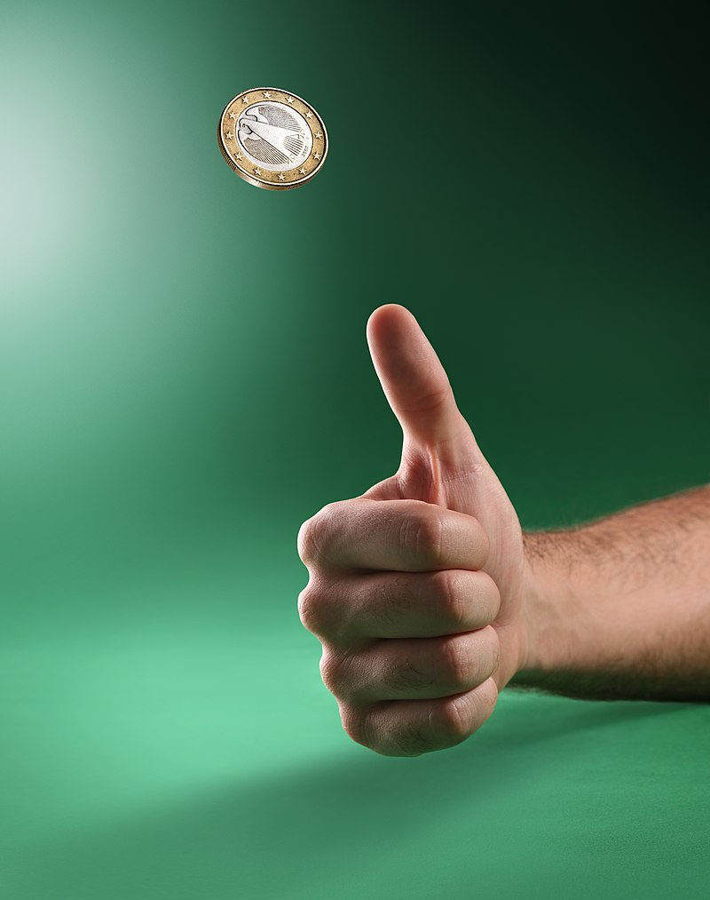
Game 1: Flicking
Flick a coin from the side of the table into the bowl
12 tries per team
Sudden death if tied after all tries

Slide 4

Game 2: Worldle
Guess the country based on its borders
Borders are not to scale
10 countries, solutions revealed at the end
Sudden death if tied after 10 rounds

Slide 5
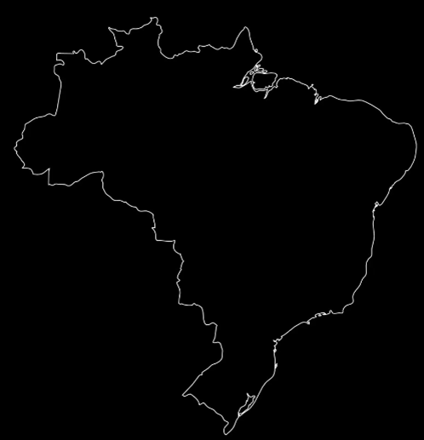
1

Slide 6

2

Slide 7

3

Slide 8

4

Slide 9

5

Slide 10
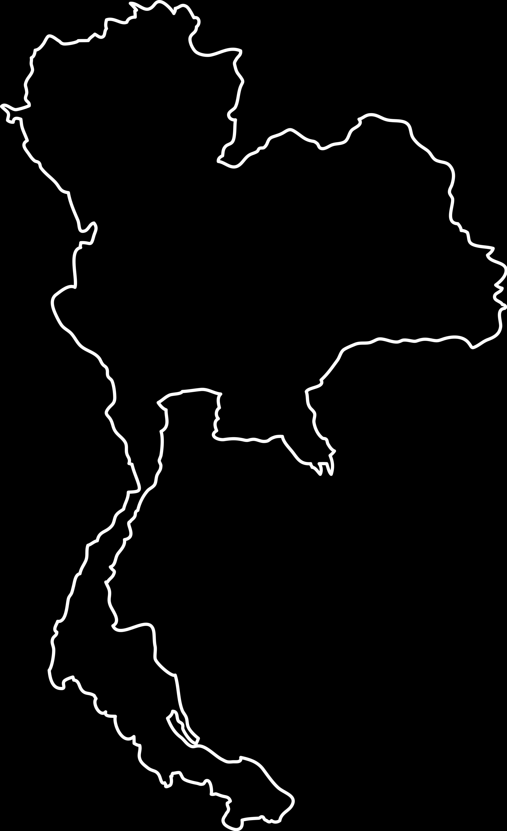
6

Slide 11

7

Slide 12

8

Slide 13

9

Slide 14
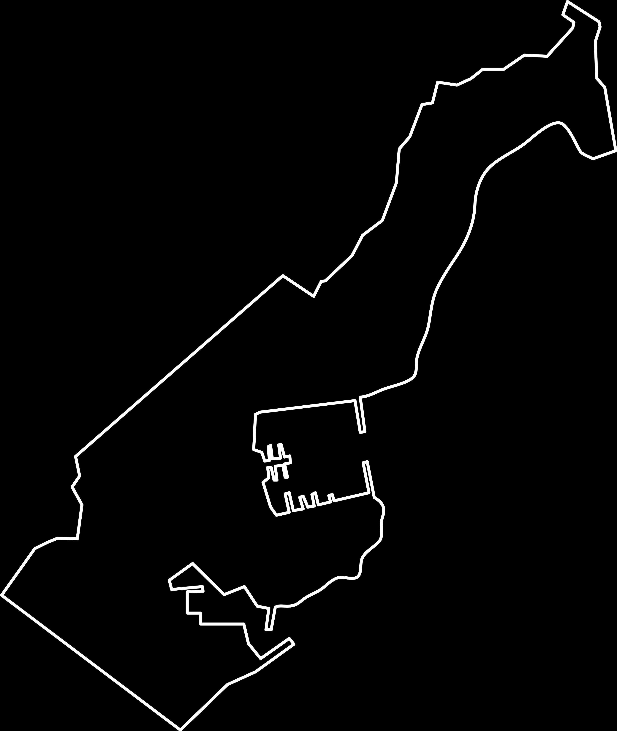
10

Slide 15
Solutions!

Slide 16
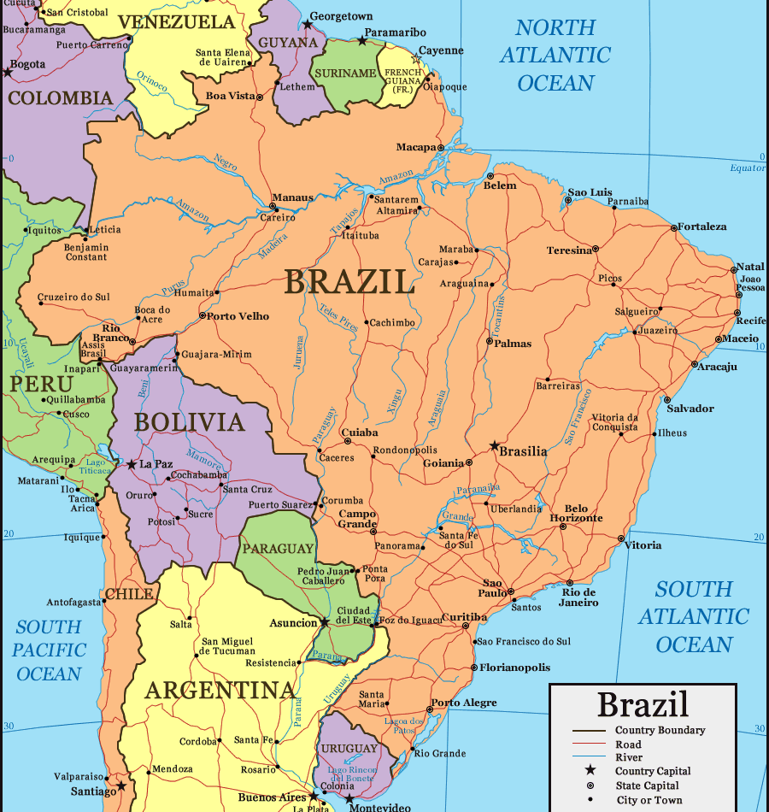
1

Slide 17
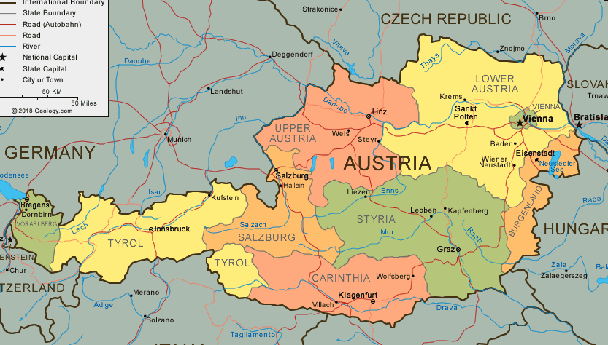
2

Slide 18
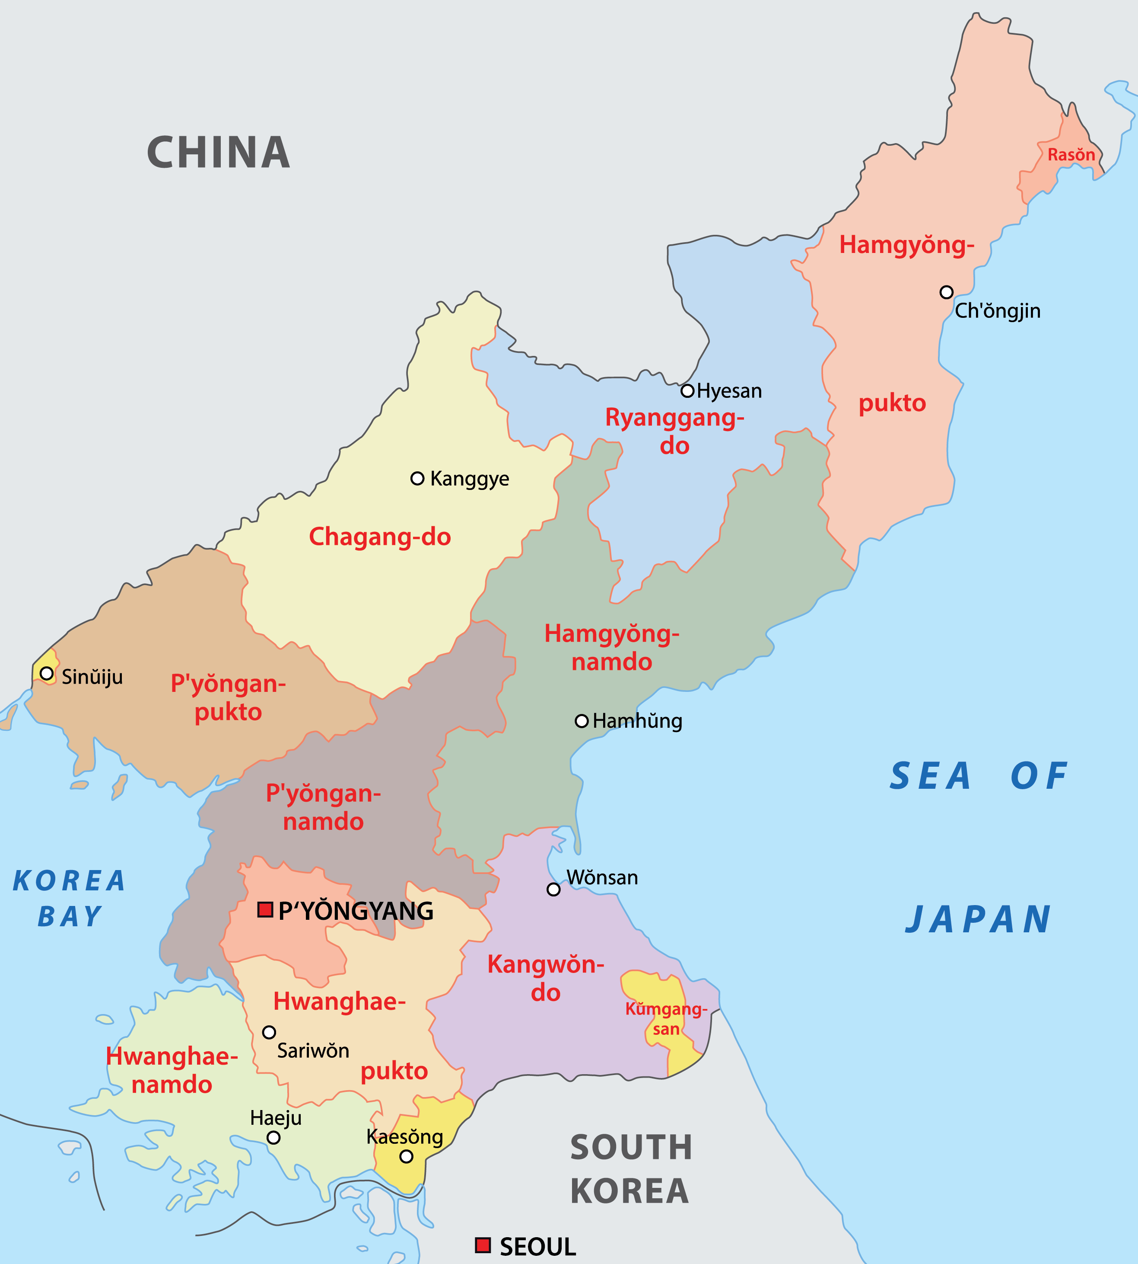
3

Slide 19
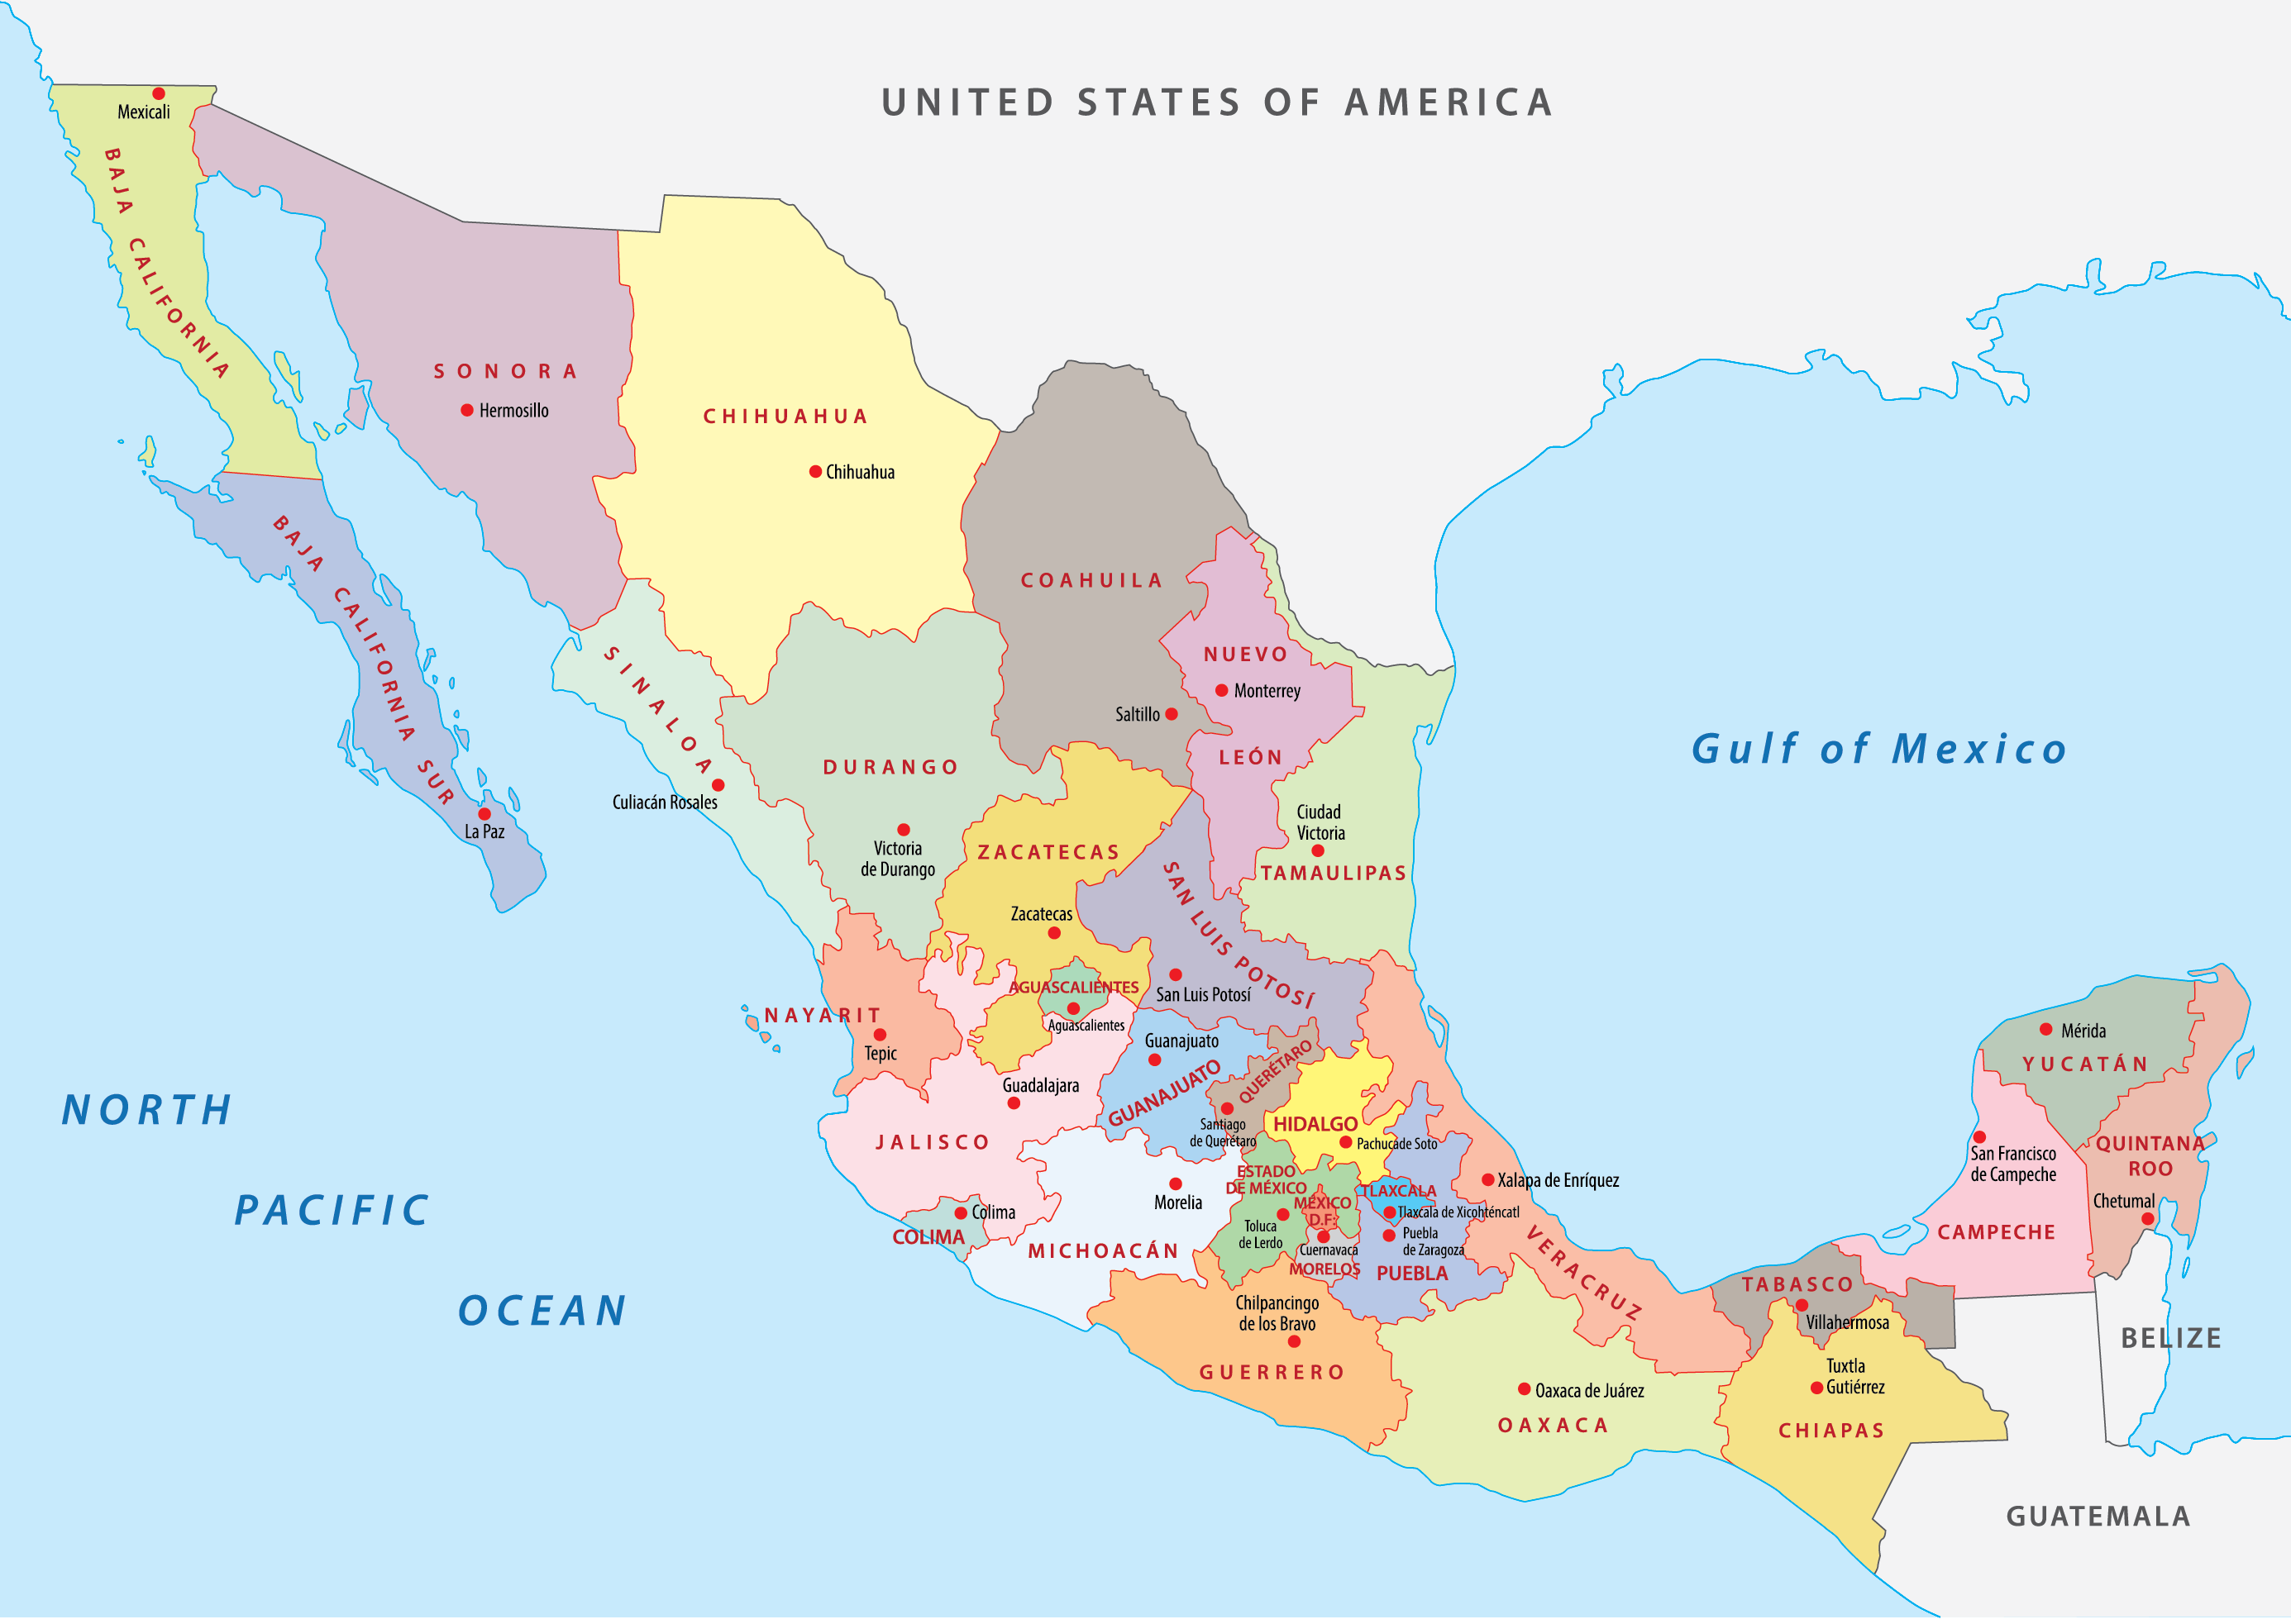
4

Slide 20
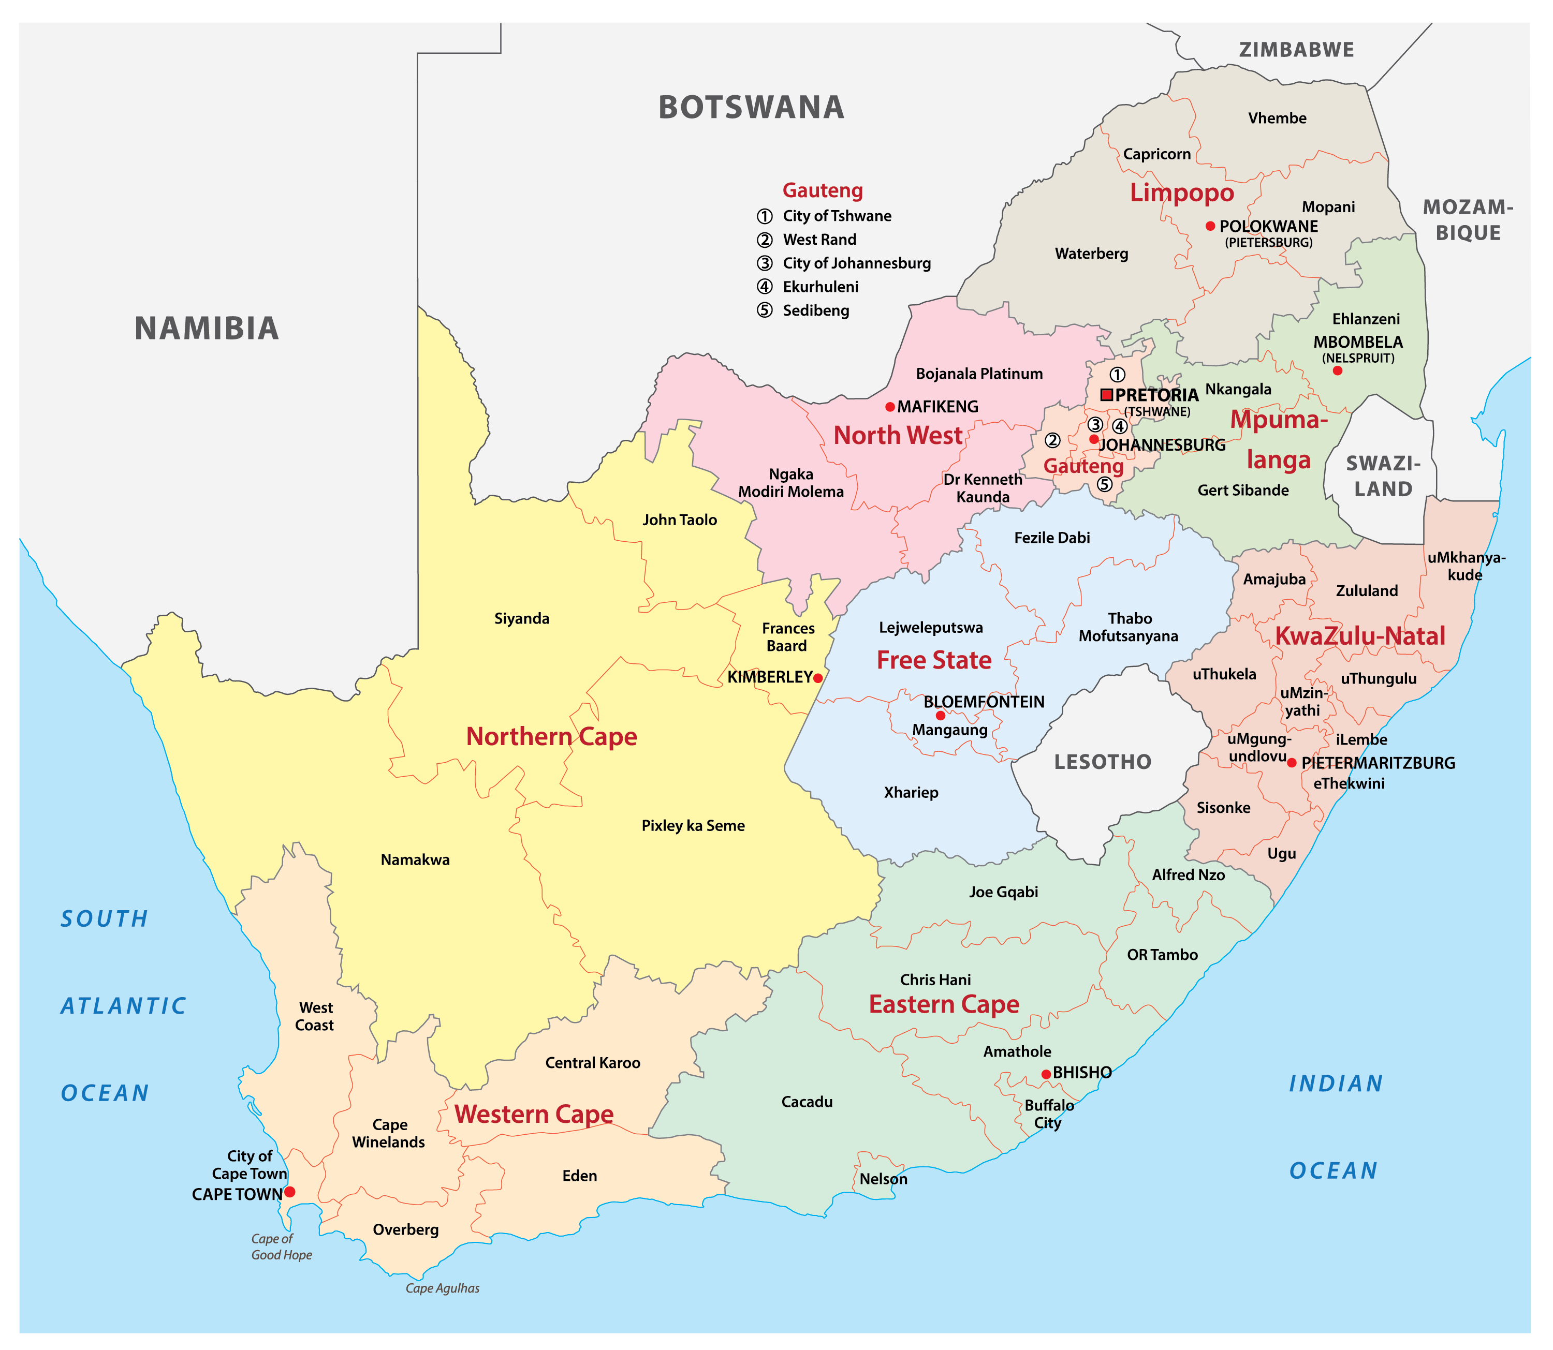
5

Slide 21
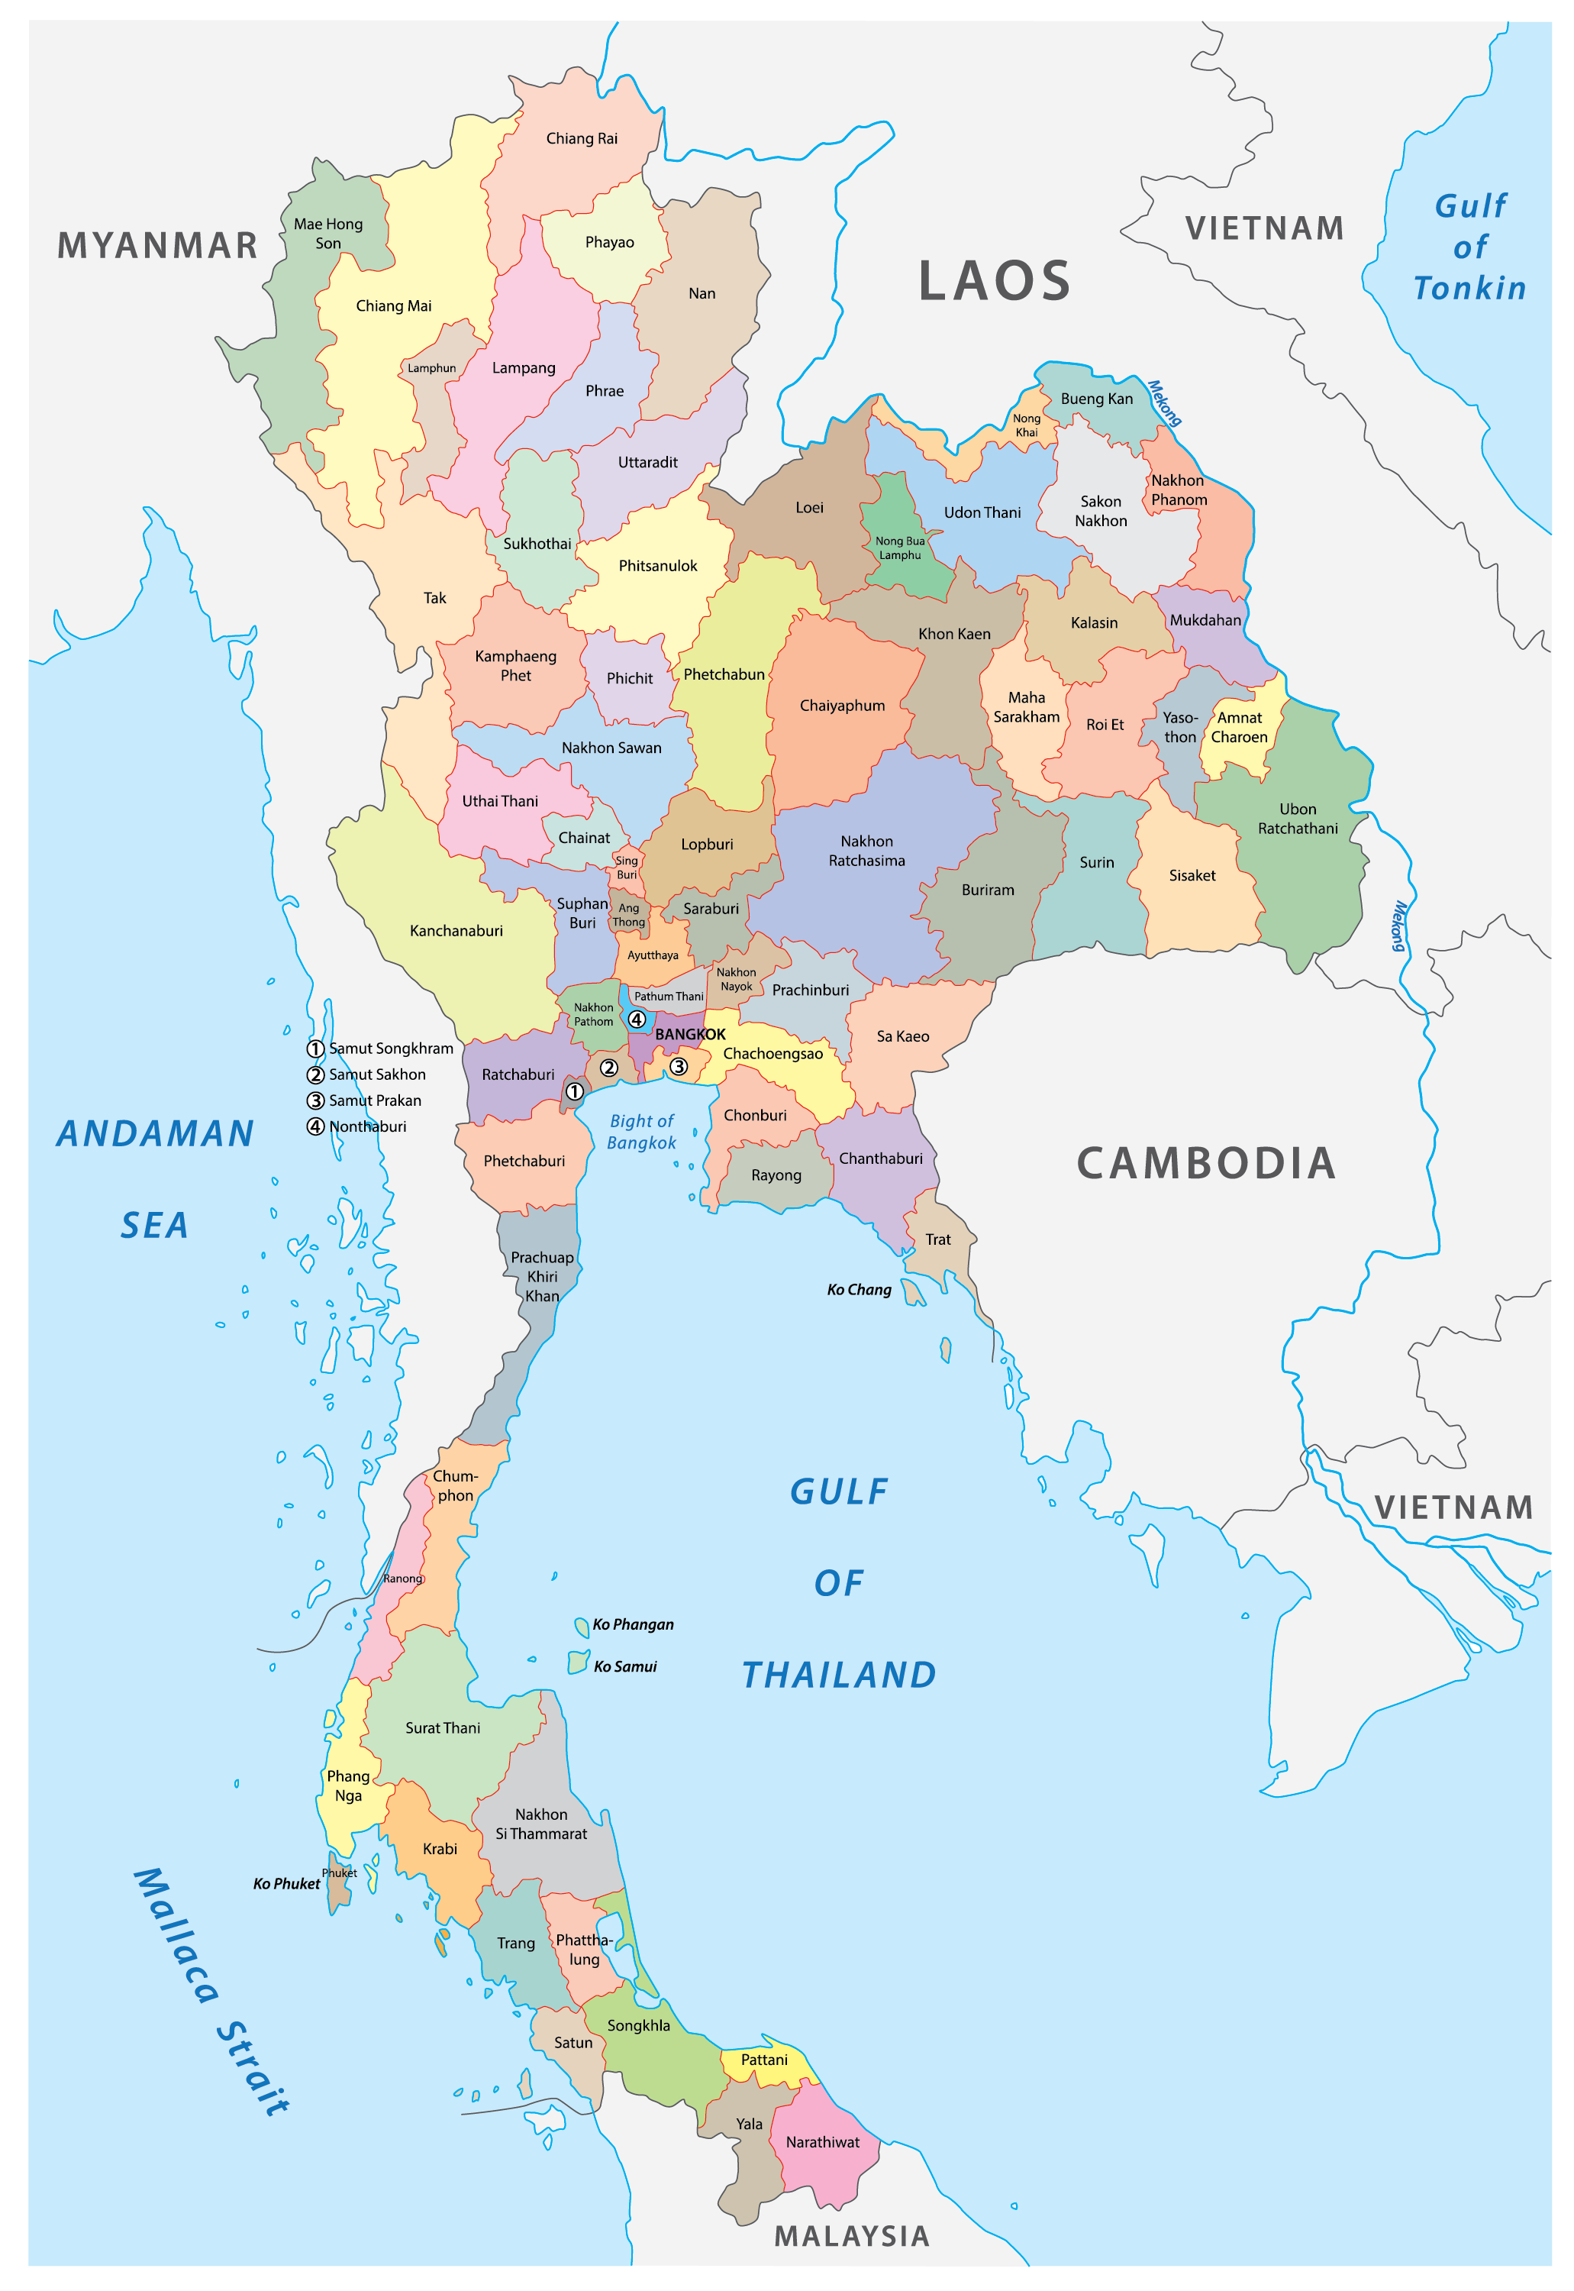
6

Slide 22
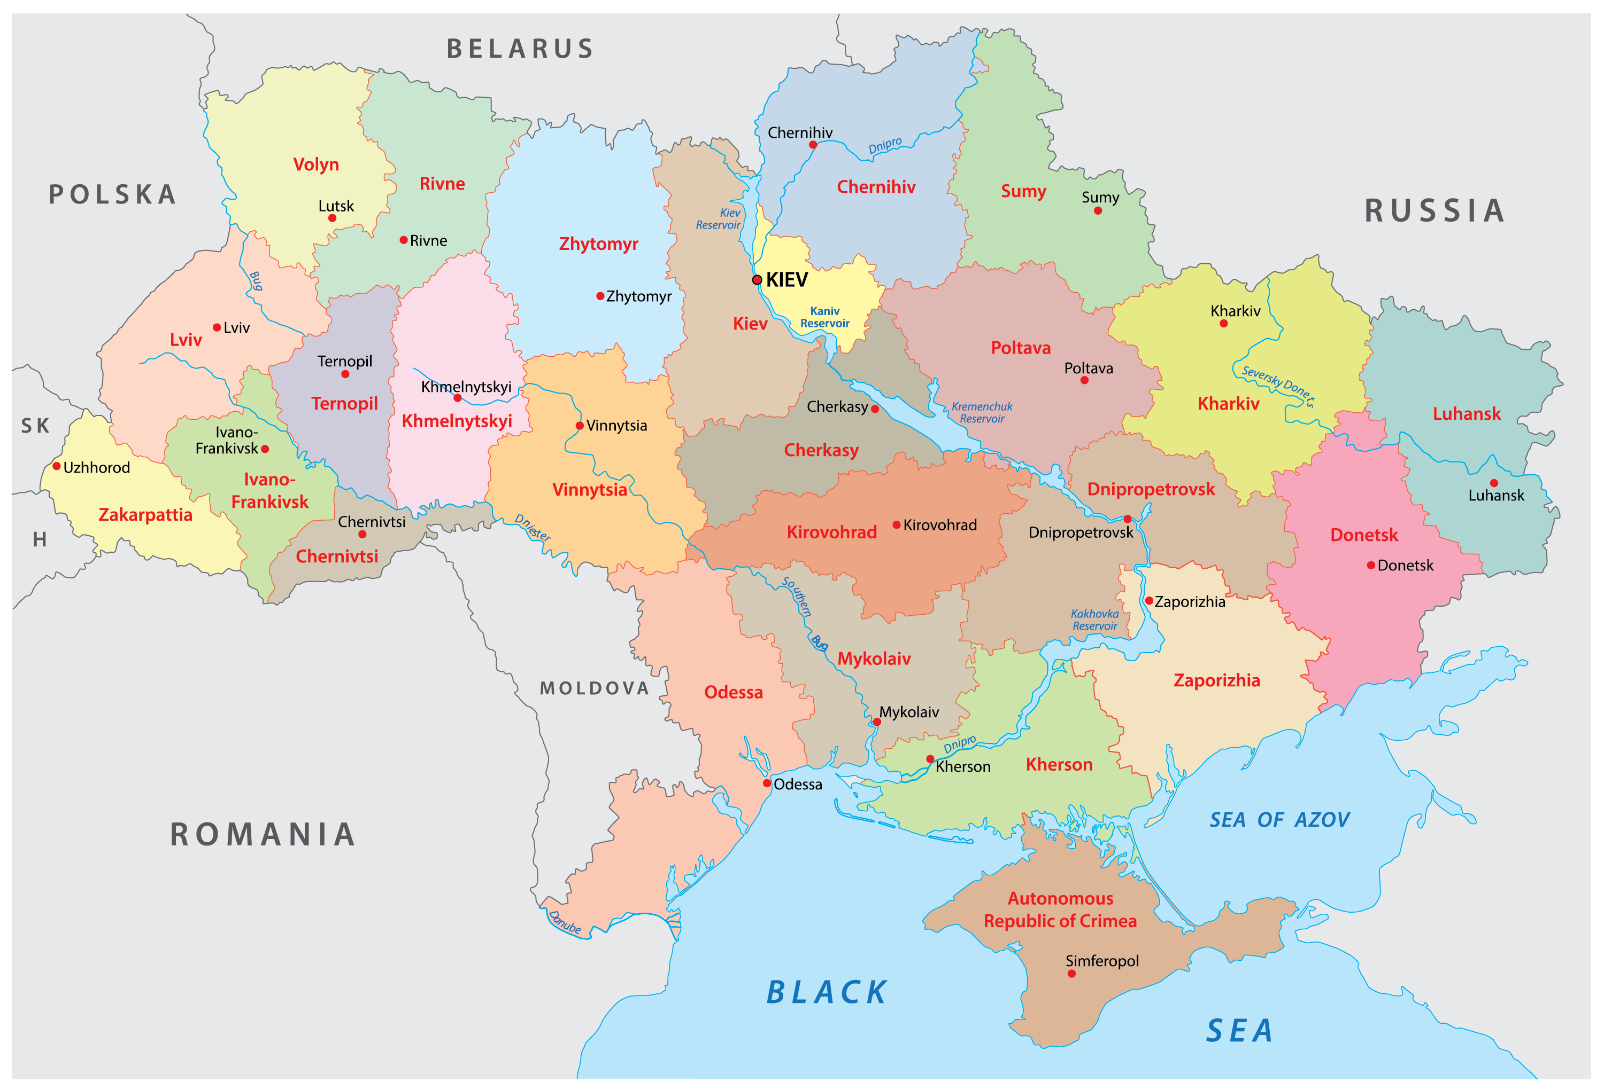
7

Slide 23
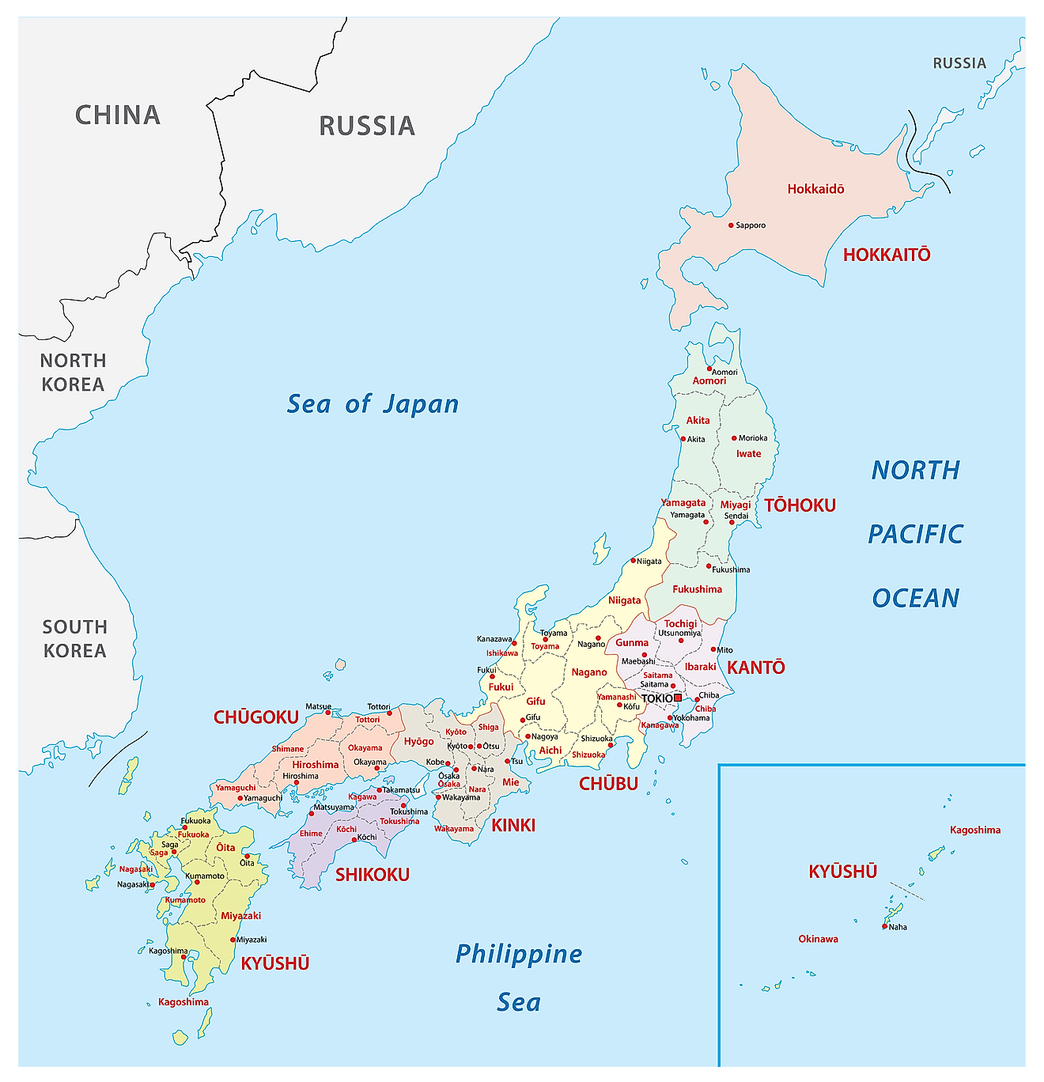
8

Slide 24
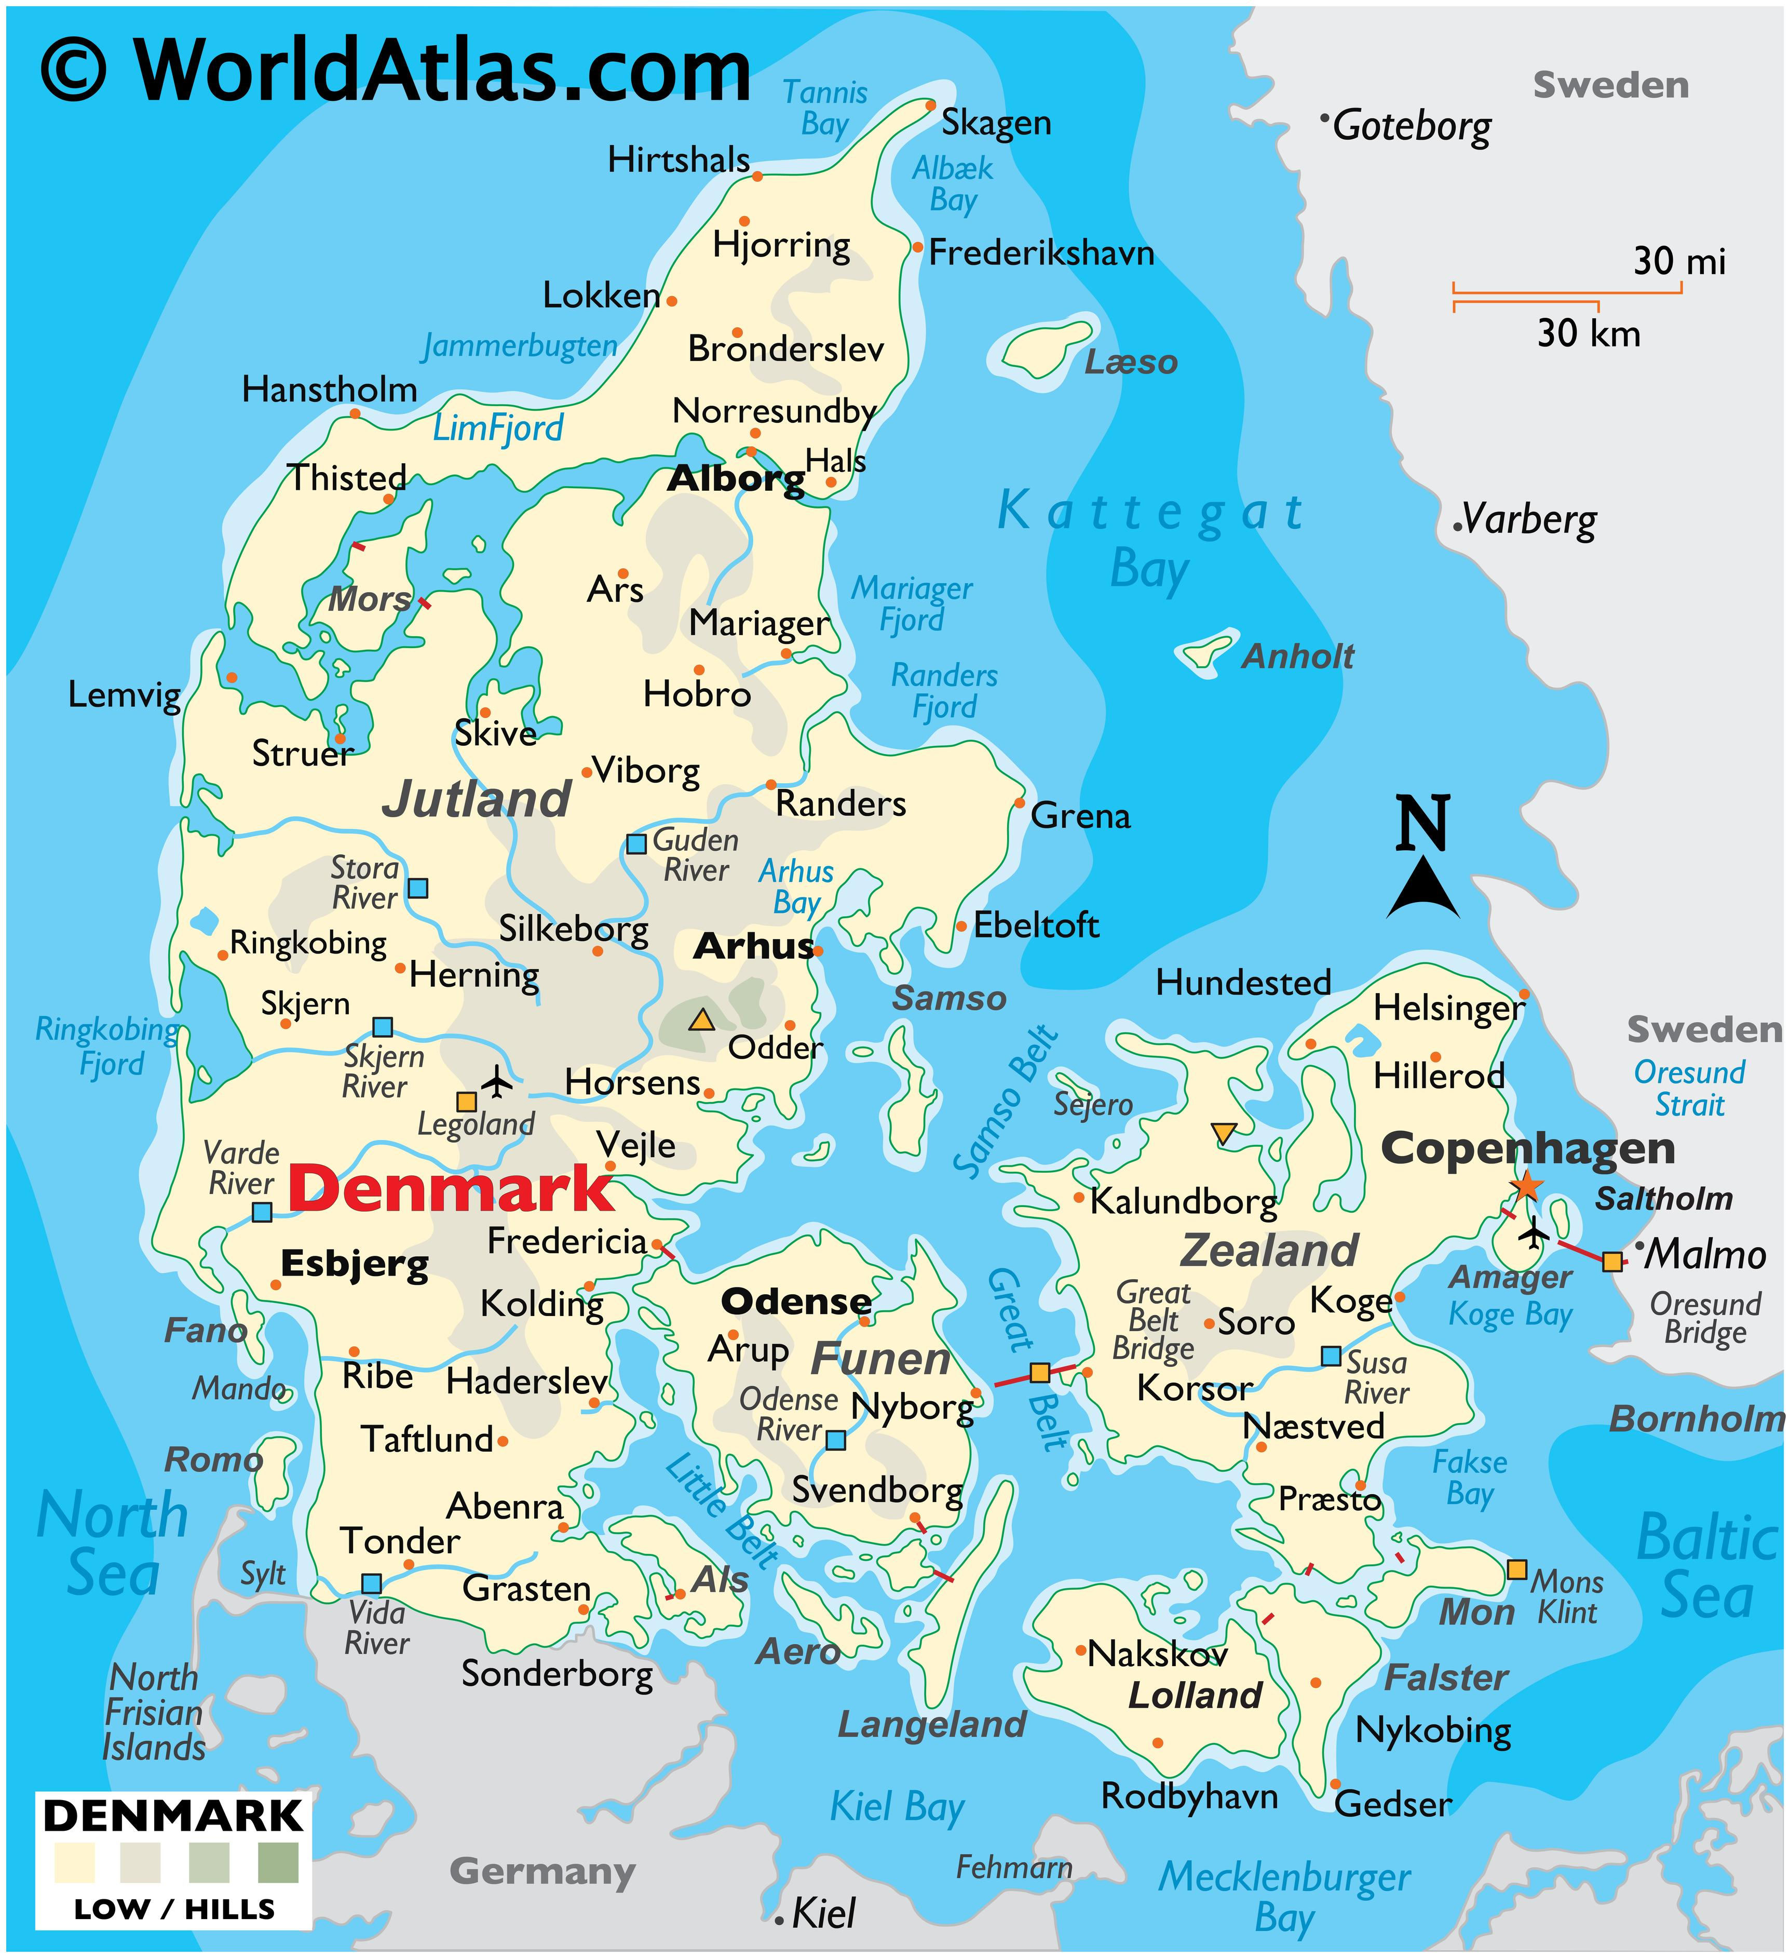
9

Slide 25
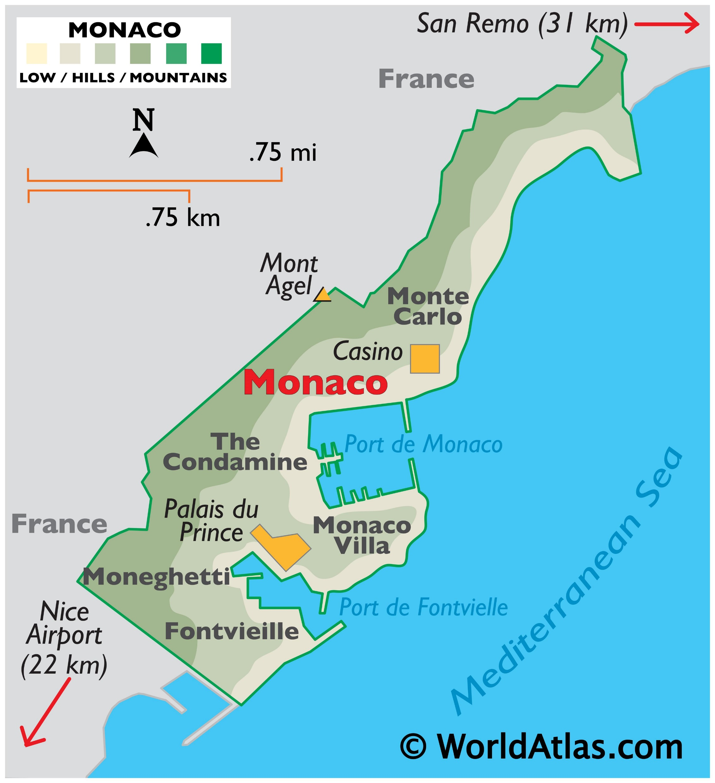
10

Slide 26
Tiebreakers!
Sudden Death → Immediate reveal

Slide 27
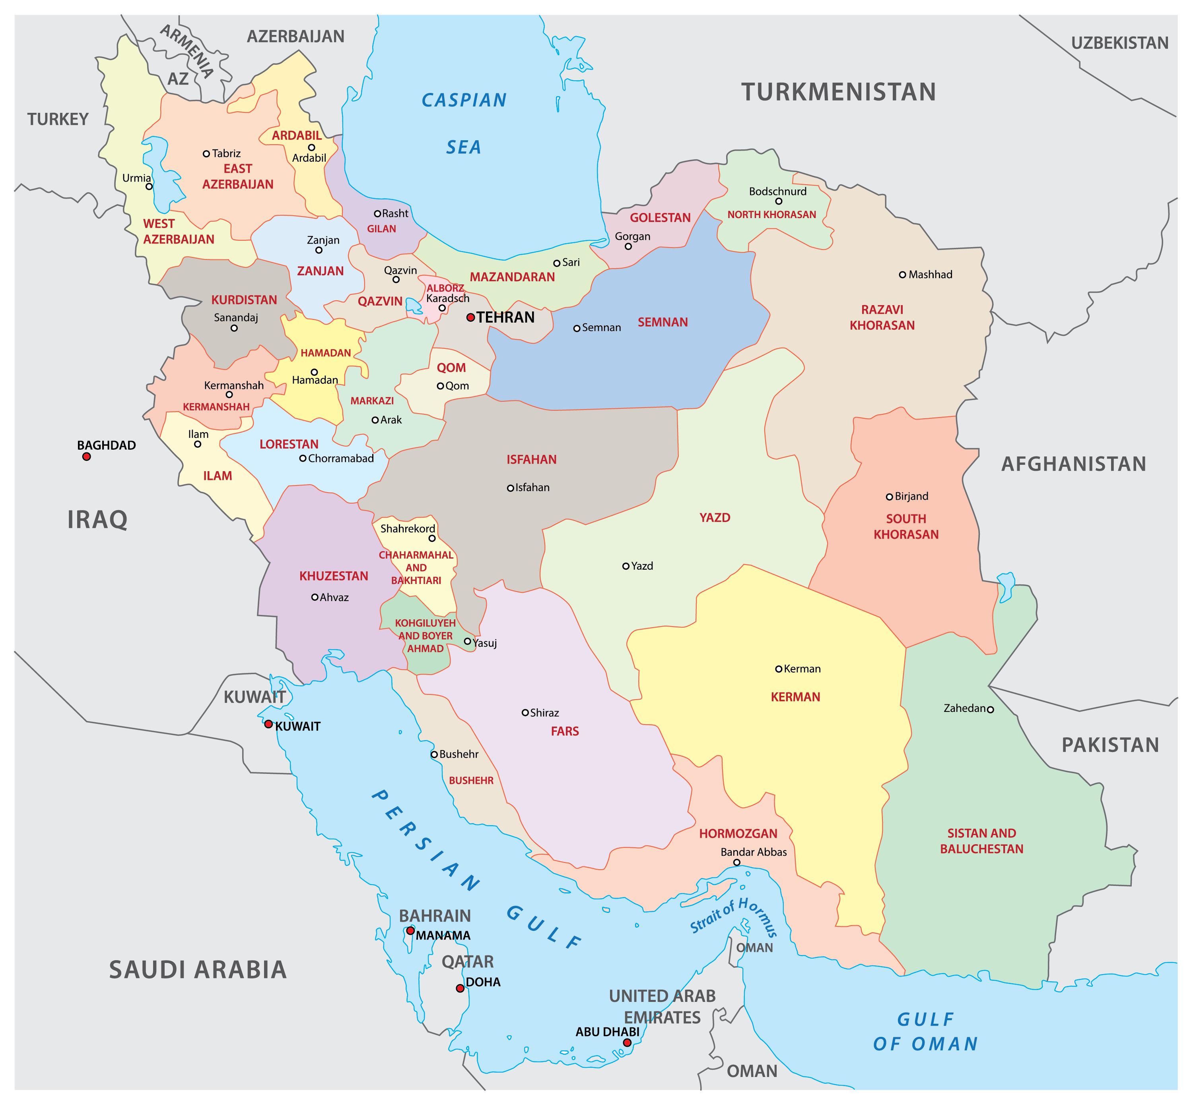


Slide 28

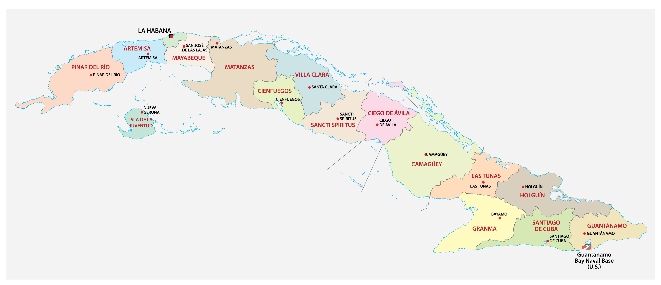

Slide 29
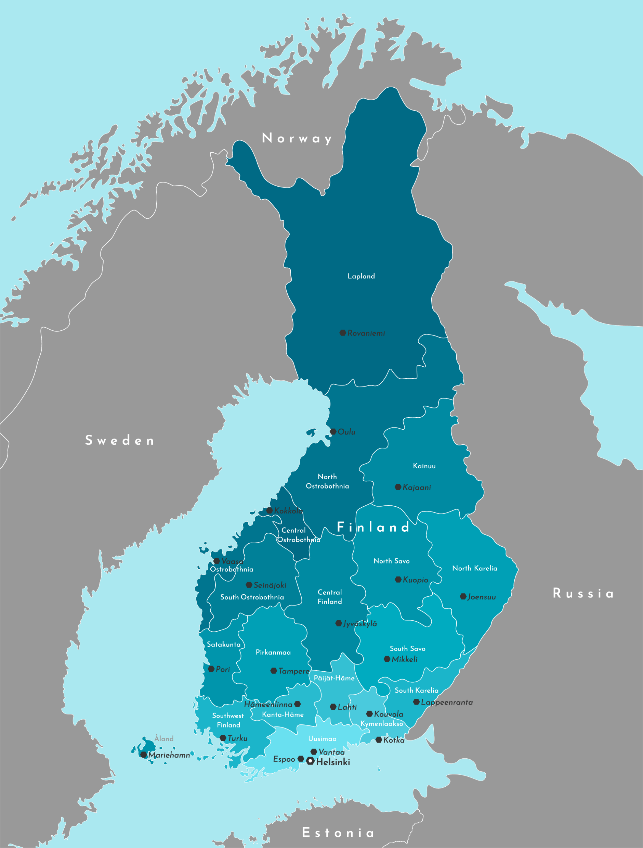


Slide 30
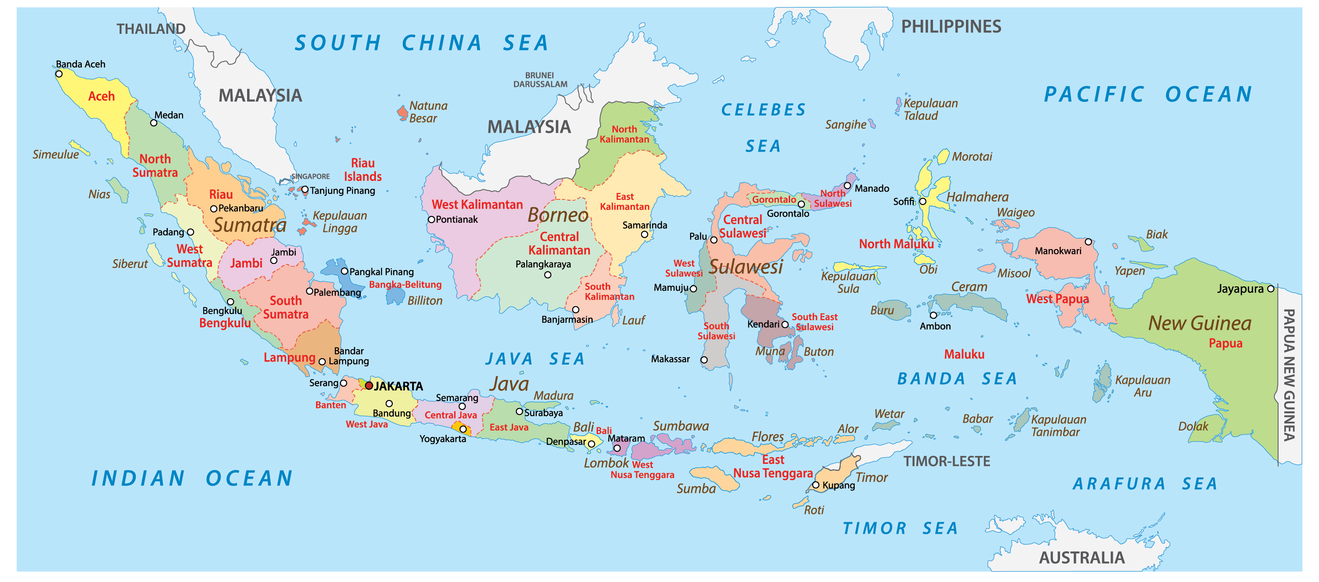


Slide 31
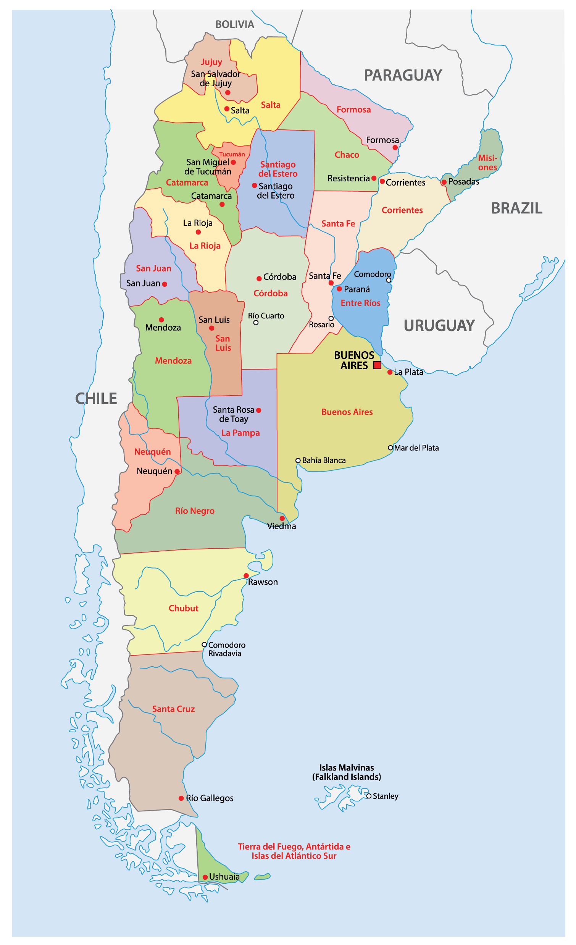


Slide 32
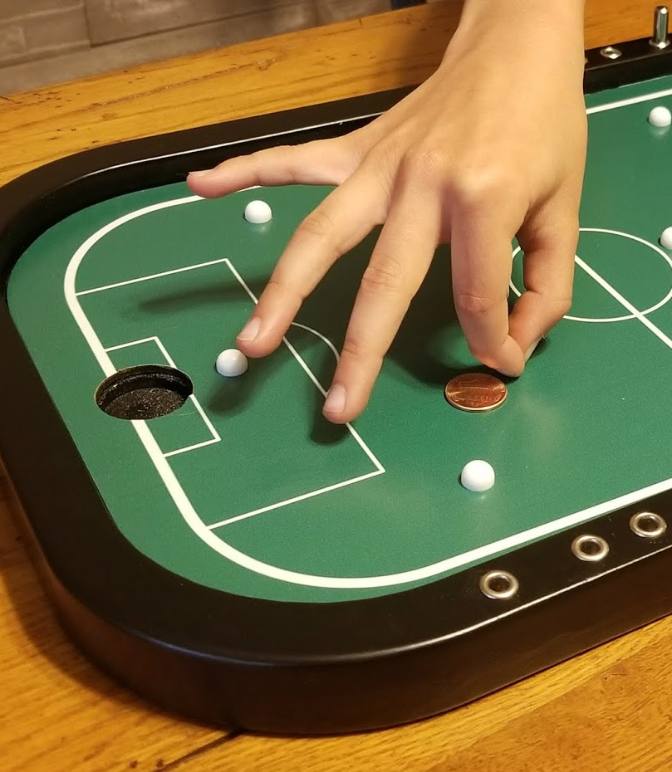
Game 3: Penny Football
Flick one bottle cap between the other two
You can only flick forward, never backward
Score by placing a cap in your opponent´s goal → lines cannot be touched
You play until you score or you make a mistake
The first team that wins 3 rounds, wins!
Notes:
Mistakes:
Failed to flick the cap between the other two caps
Two caps touch
A cap touches a line/falls off the table

Slide 33

Game 4: Googling!
Complete a search term based on a given word
The term with more Google results wins the round → Best-of-7
Terms have to be real words found in the Oxford Dictionary!
Notes:
Fill a glass with water of a certain temperature
Each group determines when the temperature should be measured
For each round, each group can only have their water measured ONCE!
3 rounds with different temperatures

Slide 34
Air…
Car…
Nose…
Beer…
Money…
Garbage…
Coffee…

Slide 35
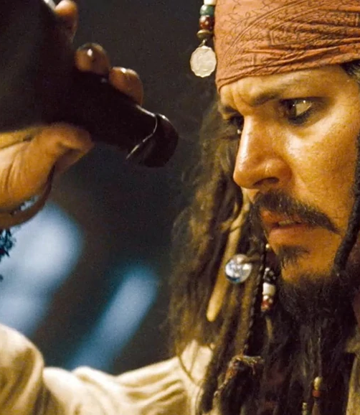
Game 5: Drink up, me hearties!
Drink a given amount of beer out of your glass
Team members compete 1v1, whoever gets closest wins the round
Each member competes once, team with most rounds wins

Slide 36
150 mL
90 mL
210 mL
188 mL
56 mL
120 mL

Slide 37
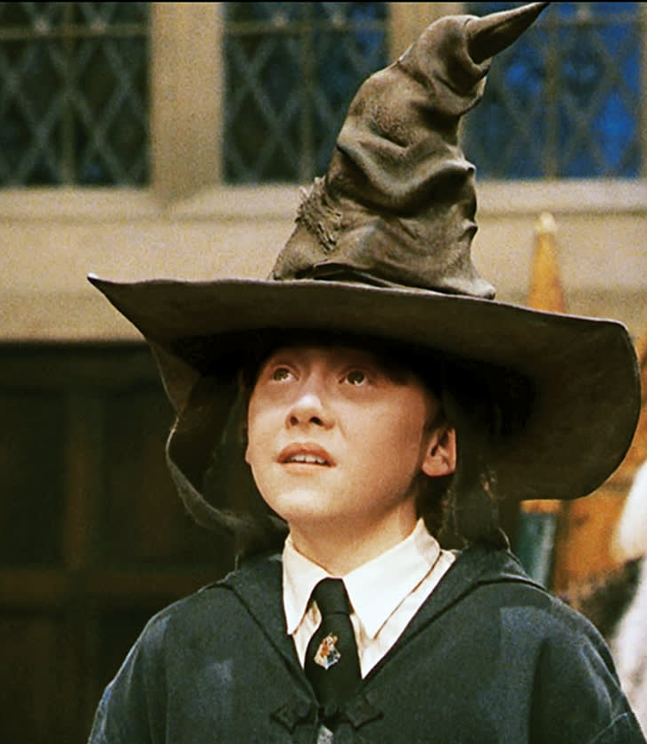
Game 6: The Sorting Hat
Correctly sort a set of answers
Indicate the position relative to already sorted answers
Team gives alternating answers until one team makes a mistake (1 min time limit)
The first team that wins 4 rounds, wins!

Slide 38
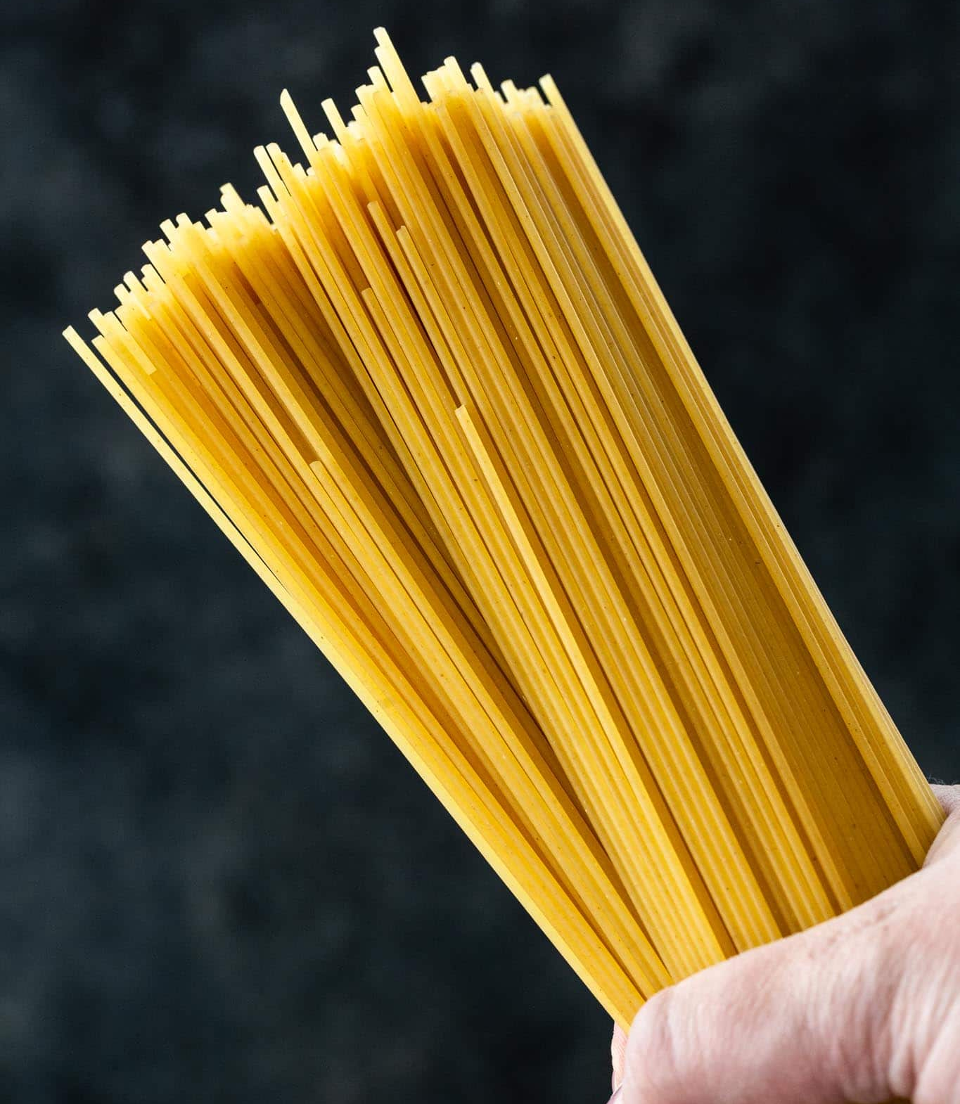
Game 7: Spaghetti
Grab a spaghetto faster than your opponent after the signal tone!
Team members compete 1v1, whoever holds the larger piece in their hand wins
The first team to win 6 rounds, wins!

